Slide 1
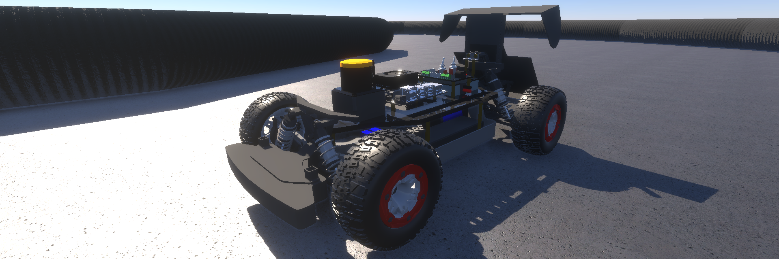



4 th ROBORACER SIM RACING LEAGUE

Slide 2
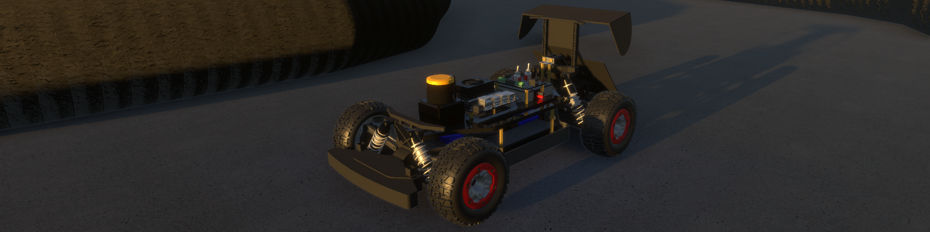
4 th ROBORACER SIM RACING LEAGUE

